Slide 1
Bank loan of customers Analytics Report
P328|Group-1
Group Members:
Arati Manikappa Telang
Mr.Yuva Tejesh Reddy Tadimarri
Mr. . KARTHIK RS
Hariom Pramod Shinde
Manjunath Mallikarjun Madiwalar
Ranjeet Kumar
Priyanka Kukshal

Slide 2
CONTENTS
Introduction
KPI-1: Year wise loan amount Stats
KPI-2: Grade and sub grade wise revol_bal
KPI-3: Total Payment for Verified Status Vs Total Payment for Non Verified Status
KPI-4: State wise and month wise loan status
KPI-5: Home ownership Vs last payment date stats

Slide 3
Introduction
The Project aims to analyse the Finance Dataset of Bank loan of customers, through a report to get insights from it by using different software tools such as Excel, MySQL, Tableau and Power BI.
We used for analysing, Cleaning and removing duplicates from datasets and prepared dashboard and insights accurate business decisions are made .

Slide 4
DATA SET
Date set | Finance_1 | Finance_2
No of Rows | 39k | 39k
No of Columns | 24 | 25
File Format | .CSV | .Xlsx
Data Type | Excel Data | Excel Data

Slide 5
TOOLS USED IN THE PROJECT
Excel | MySQL | Tableau | Power BI
Data Exploration Data Cleaning Pivot Table Visualization | Data Exploration Retrieving Relevant Data according to KPIs | Joining Multiple Files Visualization | Joining Multiple Files Data Exploration Data cleaning in power Query Visualization

Slide 6
DATA ANALYSIS PROCESS
Step-1: Define the Questions
Step-2: Collect the Data
Step-3: Clean the Data
Step-4: Analyze the data
Step-5: Visualize and share the insights

Slide 7
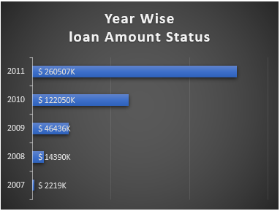
KPI-1: Year wise loan amount Stats
By observing this chart we can see how loan amount is increasing by year.
It is continuously increasing by each year as you see it‘s varies from 2M to 261M between the years 2007 to 2011.
From the year 2009, The changes in loan amount is suddenly increased with a higher rate that is around 5 times for next 2 years as compared to pervious years.

Slide 8
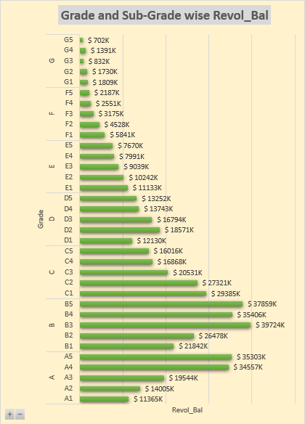
KPI-2: Grade and sub grade wise revol_bal
In this Grade and subgrade wise revol balance we can notice Grade B have more revol balance then any other grades & Grade G have very low revol balance.
The average revolving balance is higher in the ‘grade B’ its around 29M and the maximum reaches in the ‘sub-grade B3’ that is 39M, Same like the average lower revolving balance is in ‘grade G’ its around 1200K and the minimum reaches in the ‘sub-grade G5’ that is 701k.

Slide 9
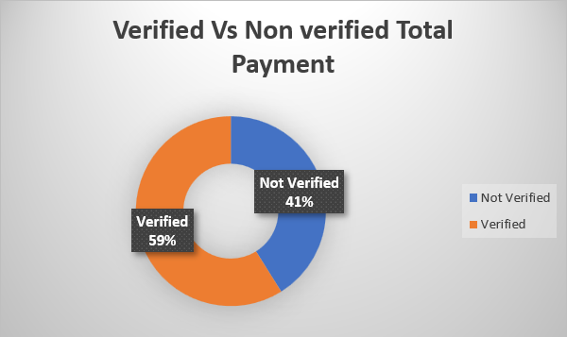
KPI-3: Total Payment for Verified Status Vs Total Payment for Non Verified Status
As we Can see in the Donut Chart that Out of $373 Million only 59% are verified i.e. $220million
41% of $373 Million are not verified i.e. $ 154 Million. Which might be a threat to company, Should inform the verification team to take required action regarding that.

Slide 10
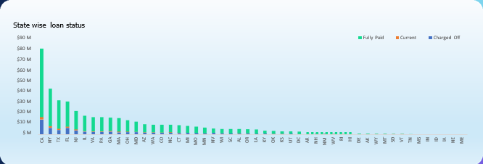
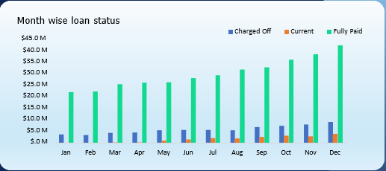
KPI-4:State wise and month wise loan status
In the data set we have different states and the months along with the 3 types of loan status.
In the state wise loan status we can observe that CA,NY,TX,FL & NJ are the top states to fully paid amount.
In the month wise loan status we can observe that Dec, Nov and oct are the fully paid amount.

Slide 11
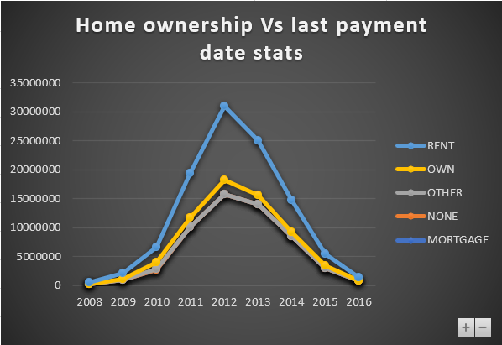
KPI-5: Home ownership Vs last payment date stats
In this chart is shown by the types of home ownership varies from 2008 to 2016.
In maximum amount reaches in the year 2012 who Rent and Mortgage house owners has paid their last payment is 12 millions and 15 millions. And the minimum amount reaches in year 2008 and payment is 0.29 millions and 0.31 millions.

Slide 12
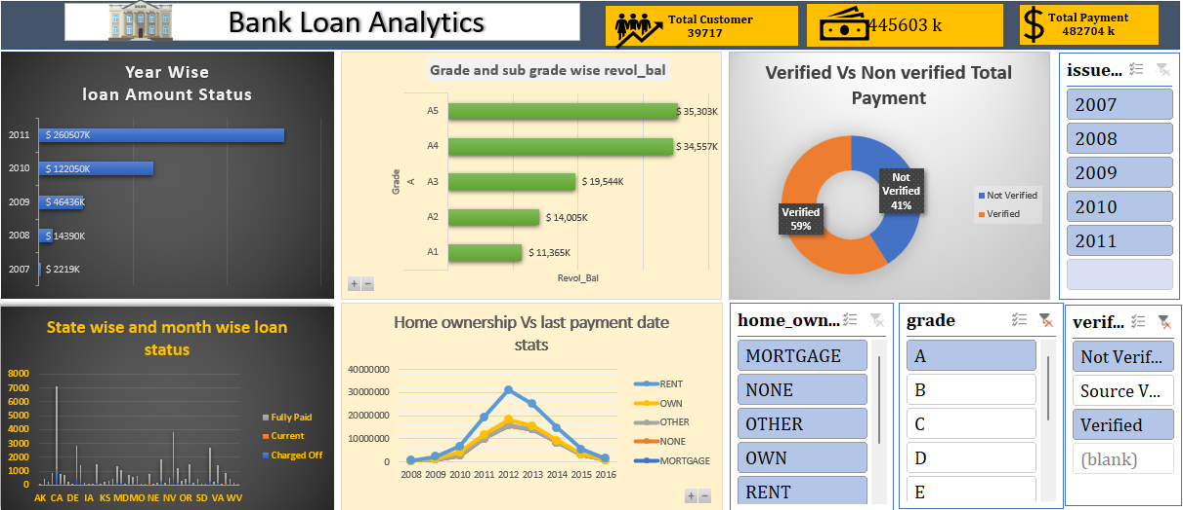
EXCEL DASHBOARD

Slide 13
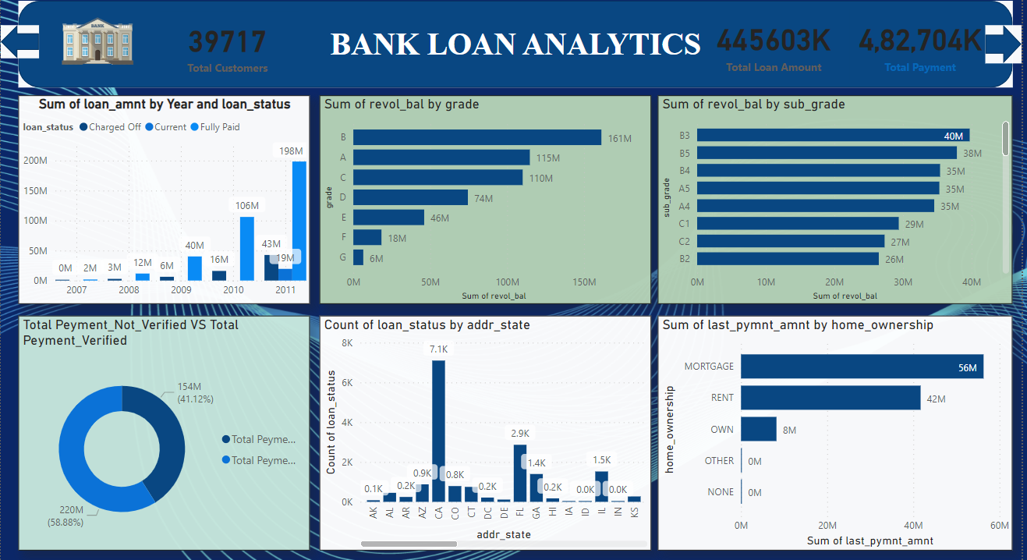
POWER BI DASHBOARD

Slide 14
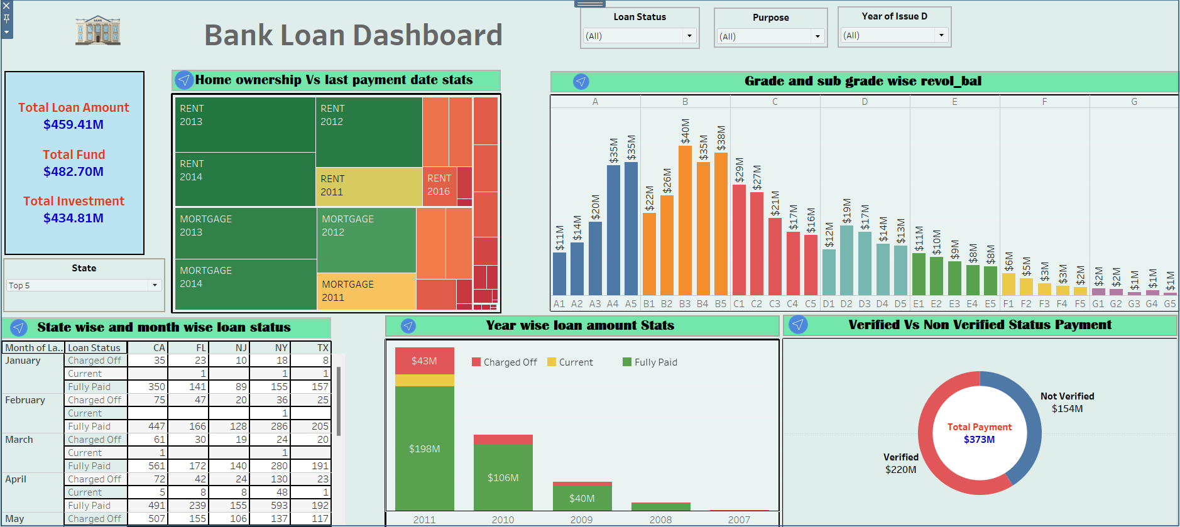
TABLEAU DASHBOARD

Slide 15
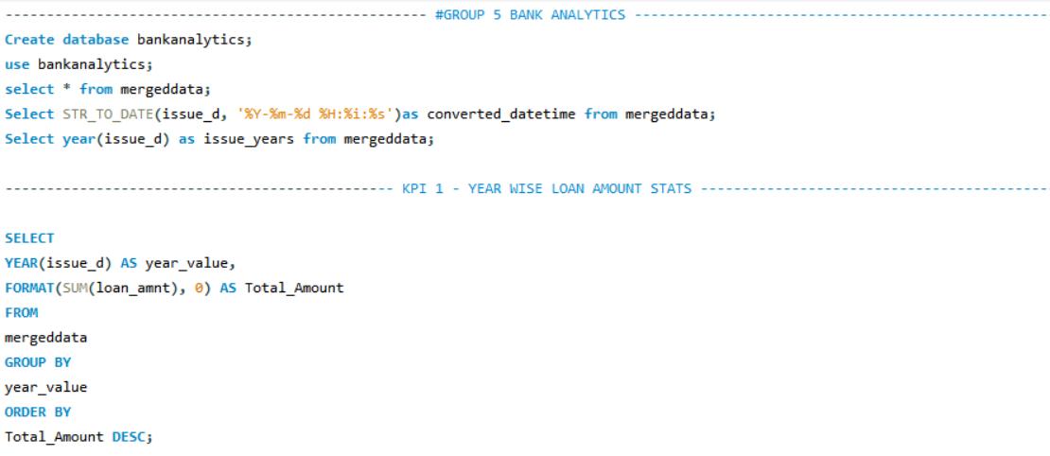
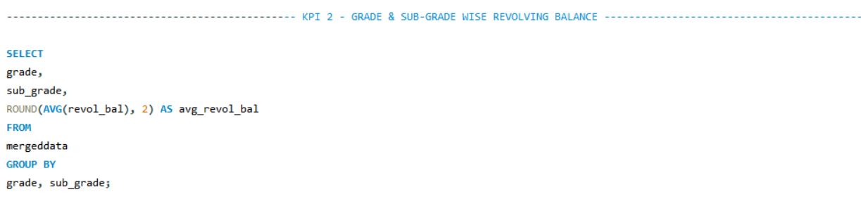
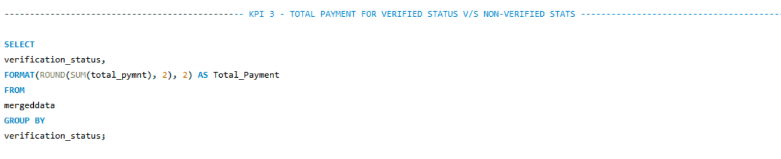
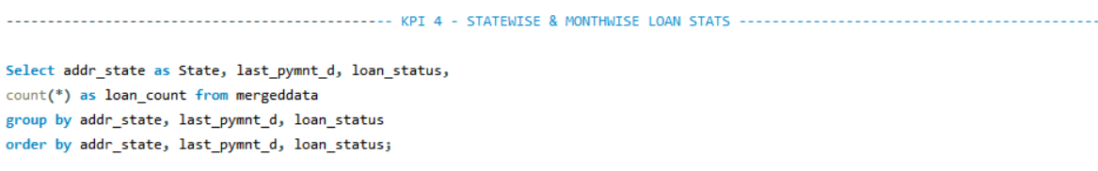
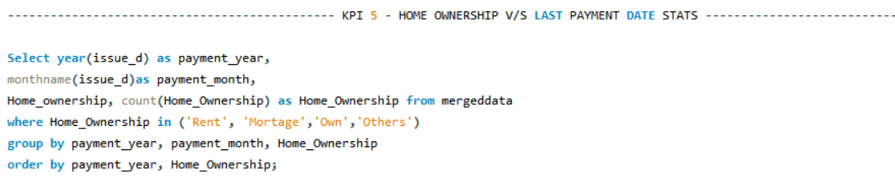
SQL

Slide 16
CONCLUSION
Bank holds a crucial role for us in day-to-day life. From the analysis of above dashboard and reports we can draw hidden insights. With the use of gained insights from the finance datasets and KPIs. Accurate business decisions are made and can track the business state. It enable a holistic view of the business, supporting long-term growth and competitiveness in the banking industry.

